Slide 1



Python for Data Science and AI
EXPLORATORY DATA ANALYSIS
20229540_Le Nguyen Thai Duong

Slide 2


HYPOTHESIS
Getting arrested is associated with driver gender
H1
-Dataset: Traffic and Pedestrian Stops by Police
-Source: Stanford Open Policing Project
Getting arrested is associated with driver age
H2
Getting arrested is associated with driver race
H3

Slide 3

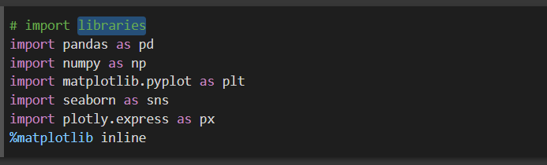

LIBRARIES

Slide 4
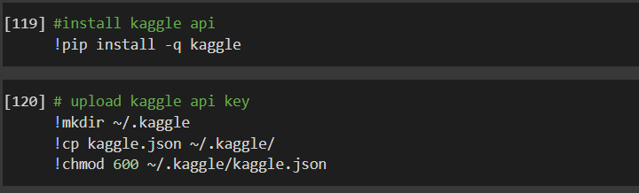
API

Slide 5
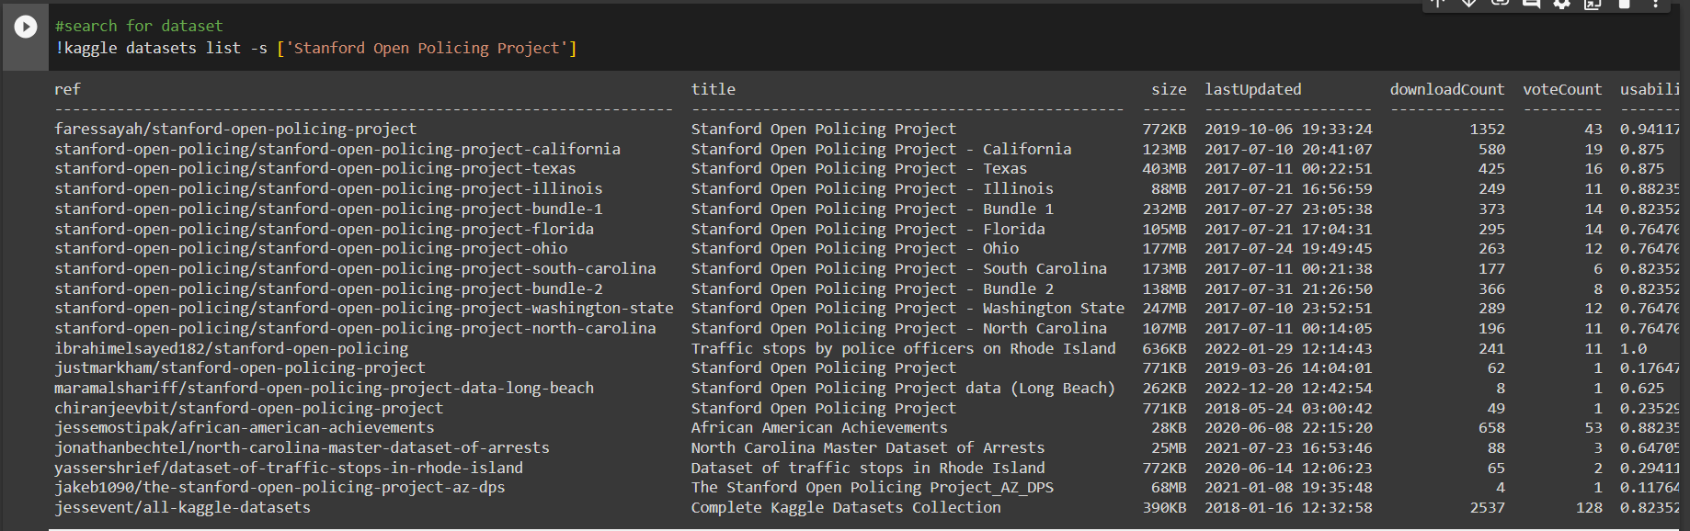
API

Slide 6
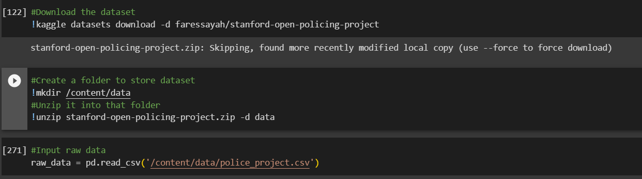
DATA INPUT

Slide 7
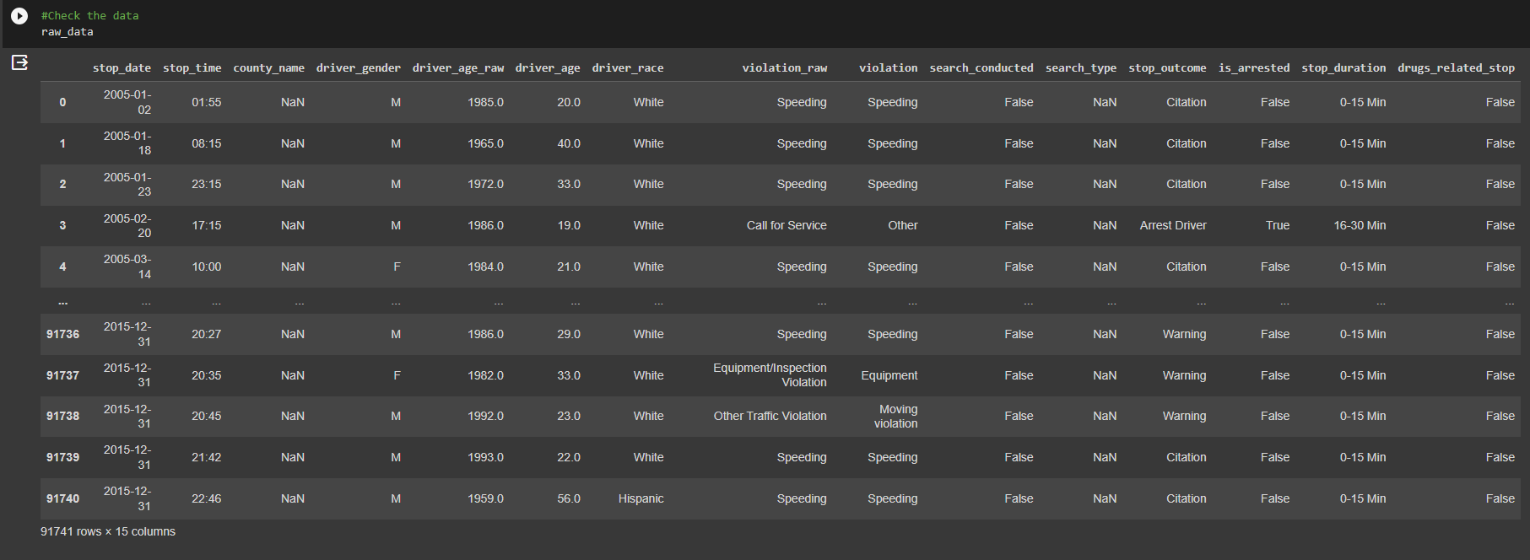
RAW DATA

Slide 8
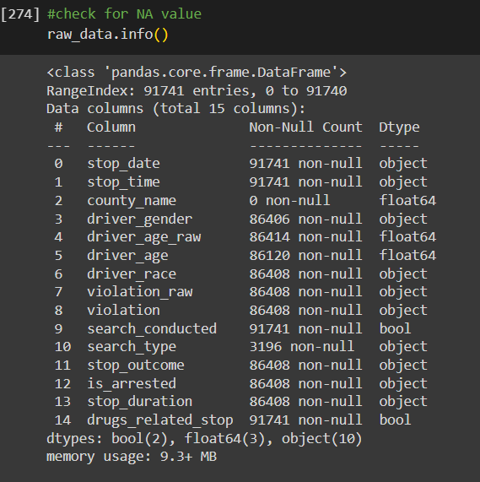
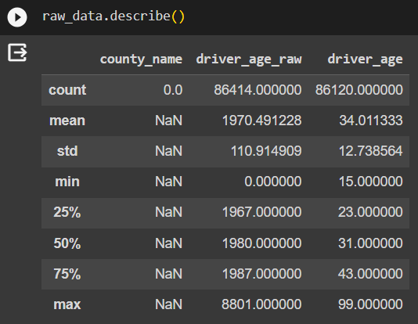
STAT AND INFO

Slide 9
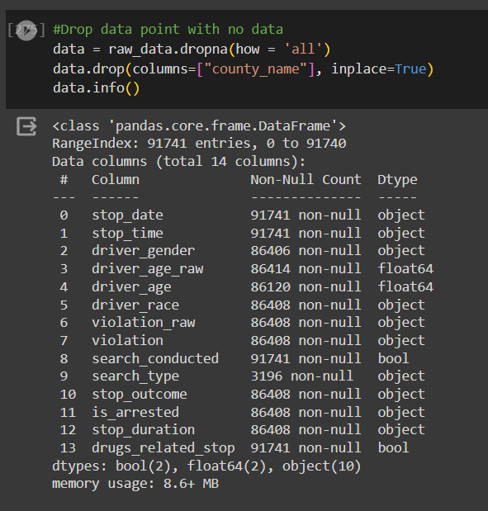
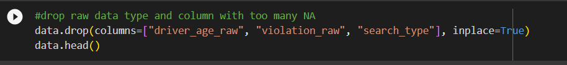
CLEANING

Slide 10
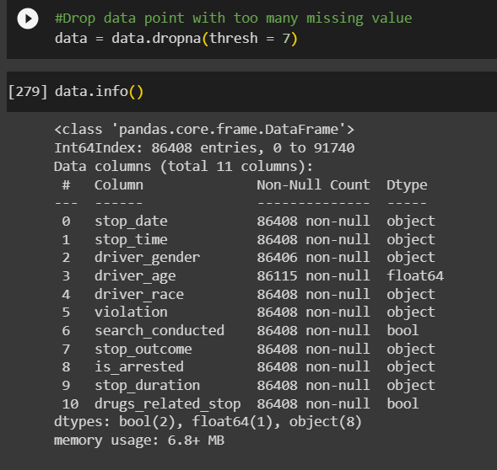
CLEANING

Slide 11
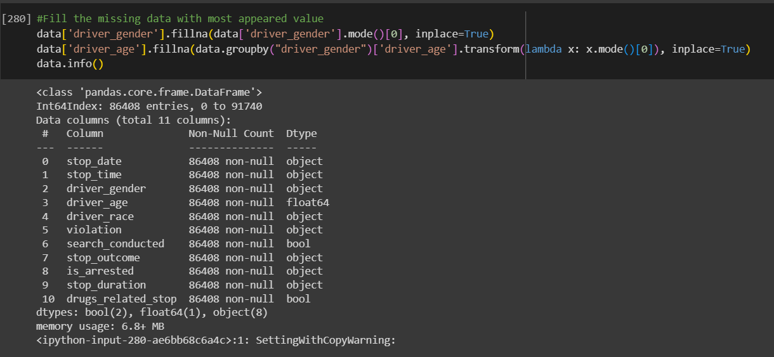
CLEANING

Slide 12
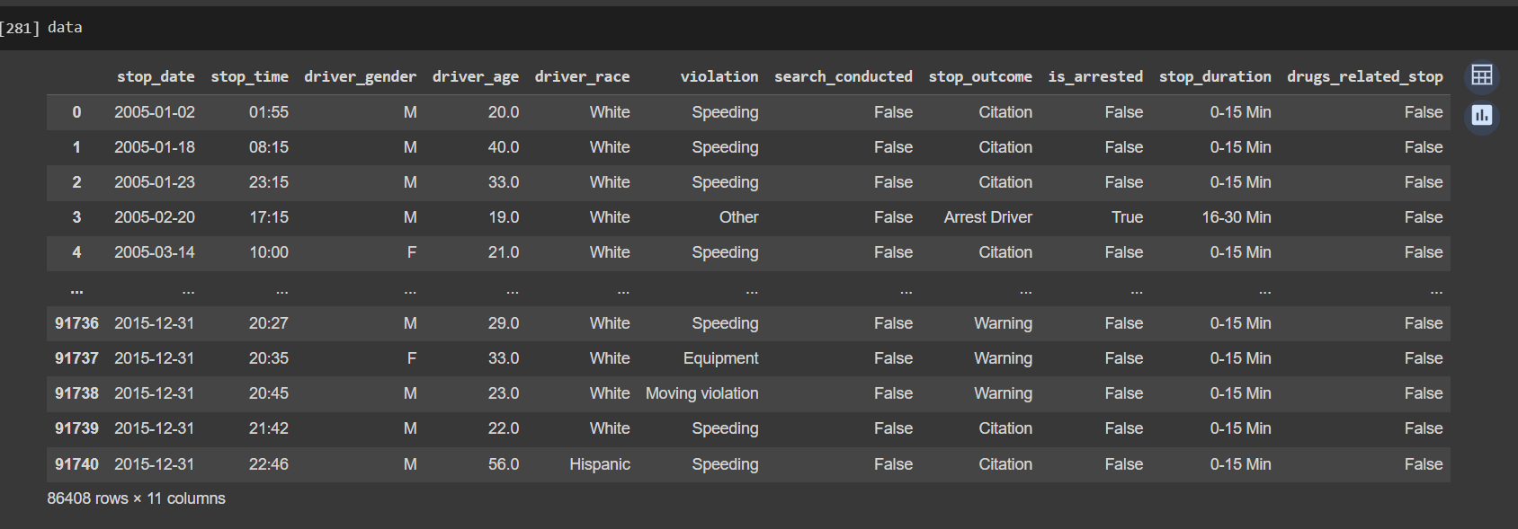
CLEANING

Slide 13
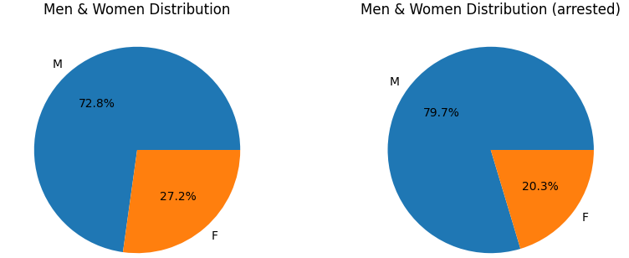
HYPOTHESIS 1
Is getting arrested associated with driver gender?

Slide 14
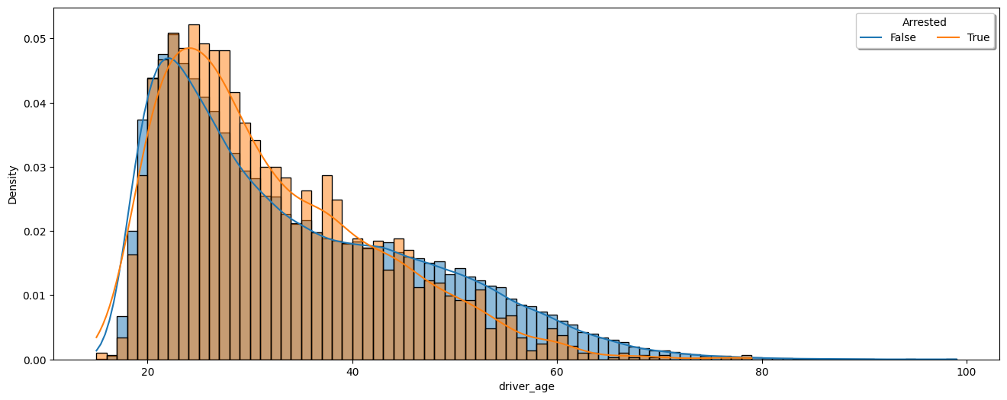
HYPOTHESIS 2
Is getting arrested associated with driver age?

Slide 15
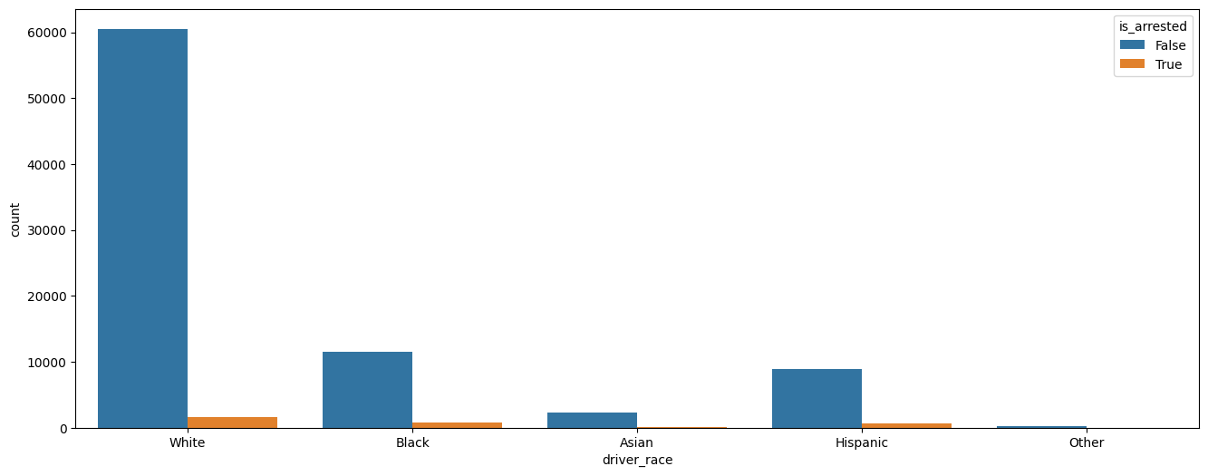
HYPOTHESIS 3
Is getting arrested associated with driver race?

Slide 16
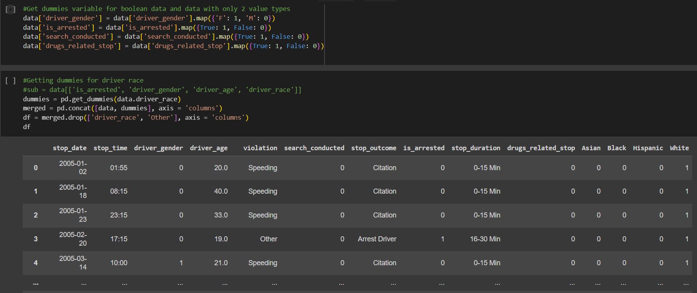
DUMMY VARIABLE

Slide 17
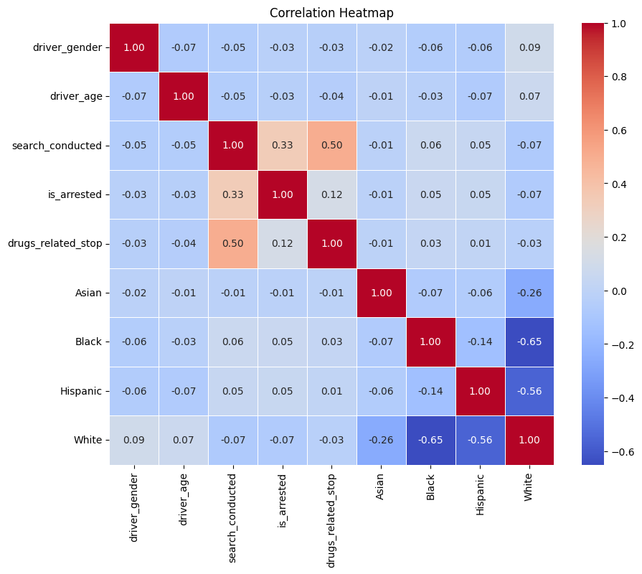
ANALYSIS
-Getting arrested is not associated with driver gender
-Getting arrested is not associated with driver age
-Getting arrested is not associated with driver race
Side discovery
-If a search is conducted, it tends to relate to drug

Slide 18
THANK YOU FOR LISTENING
20229540_Le Nguyen Thai Duong

